Slide 1
Secrets to SSH
A Sharpe curriculum

Slide 2
Secure Shell (SSH)
Just a few quick basic facts
Runs on TCP
Port 22 (discuss: can it run another port?)
Originally designed to replace Telnet (stop spying on my password!)

Slide 3
Don’t call me Telnet v2
Supports much more!
File transfers (SCP/SFTP)
Port forwarding
Passwordless authentication with keypairs, or 2FA if you use key AND password
X11 forwarding
MORE

Slide 4
Secrecy - Diffie Hellman
This isn’t specific to SSH. It’s used anytime a modern encrypted transport protocol wants to establish a secure connection.
SESSION KEY

Slide 5
Asymmetric vs symmetric
Asymmetric encryption involves two keys that are a pair. Public/Private keypairs
Symmetric has a single key, also known as a session key. Diffie Hellman is responsible for setting up a session key or what you could call a one time symmetric key.

Slide 6
Be clear - secrecy vs authentication
The first step to any connection that is to be secure is secrecy and is handled by Diffie Hellman. This step does not handle authentication on its own.

Slide 7
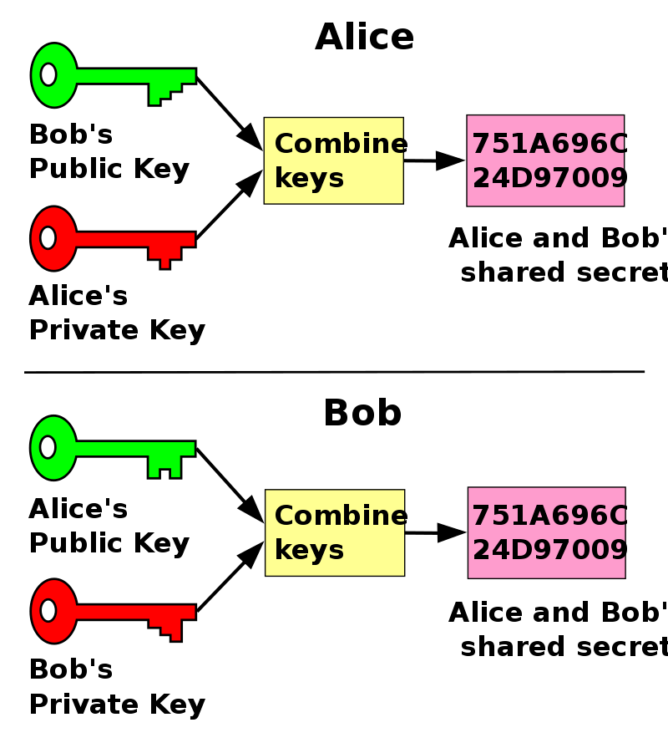
Visual
Each and every time the client and the server generate brand new public/private key pairs for every new connection. This provides perfect forward secrecy. Image: Wikipedia

Slide 8
Don’t get distracted
I know you saw public/private keys. Those have nothing to do with authentication. Those are temporary keys and have zero to do with the next topic authentication.

Slide 9
Recap Diffie Hellman - video
https://www.youtube.com/watch?v=d1KXDGgwIpA
Been trying to explain for years, best video I’ve ever seen on the topic.

Slide 10
USER Native authentication
Username and password
Username and key pair
Username, password AND key pair 2FA
But if we dig into the realm of PAM or Linux Pluggable Authentication Modules then we can extend SSH authentication capabilities

Slide 11
SSH using PAM plugins
Google Authenticator
Using a Yubikey!
Use just a plain USB drive
Search around, let me know if you find something else.

Slide 12
Two way authentication
Why?

Slide 13
For Man In the Middle Attacks of course!
Bugs Bunny Donald Duck Rabbit-HQ
Donald Duck could establish two connections
Between Bugs Bunny and Donald Duck
Between Donald Duck and Rabbit-HQ

Slide 14
For Man In the Middle Attacks of course!
Bugs Bunny Donald Duck Rabbit-HQ
If we did not use any server authentication Bugs Bunny would have NO IDEA that Donald Duck was forwarding packets on behalf of Rabbit-HQ

Slide 15
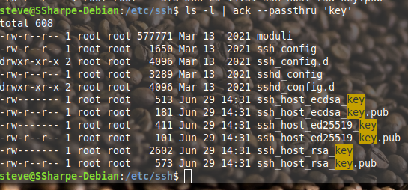
Viewing the servers public key
Note: Some say pub, some do not.

Slide 16
Viewing the servers public key
Note: There is also ecdsa, ed25519 & rsa

Slide 17
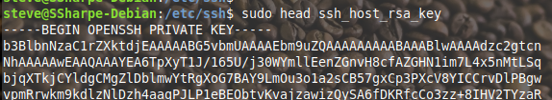
Let’s look at a file without pub
It’s a private key!

Slide 18
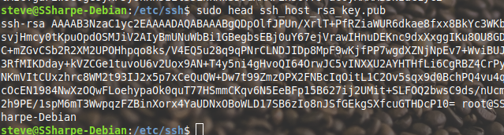
Let’s look at a file with pub
It’s a public key!

Slide 19
Why so many keys?
Noticed there was key pairs for ecdsa, ed25519 & rsa. You only need to authenticate with one but multiple key pairs are used because servers typically offer multiple types of keys

Slide 20
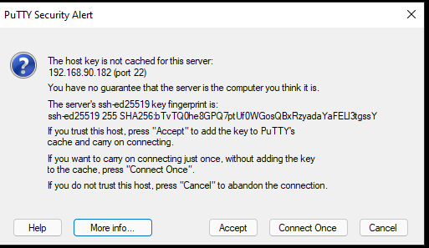
Remember this warning
You get this warning when you first connect. This is a mapping between a host and its stored hash.

Slide 21
First time connecting
Bugs Bunny Donald Duck Rabbit-HQ
Say this is your first time connecting to Rabbit-HQ. You would accept the server’s public key, but you would have NO IDEA that this was actually Donald Duck doing a MITM attack.

Slide 22
First time connecting
Bugs Bunny Donald Duck Rabbit-HQ
HOWEVER, if you had previously connected to Rabbit-HQ and stored the hash of Rabbit-HQ public key in your known hosts then Donald Duck could not impersonate Rabbit-HQ.

Slide 23
There are limits
If you absolutely need to make first time connections with the least amount of MITM attack possible then SSH is not the right choice. This is where you would employ a certificate authority. SSH does support a CA but that needs to be guarded very, very well.

Slide 24
Native authentication
Last lab you configured username and password authentication. A popular way to authenticate is with key pairs. We discussed authenticating that the server is who the server still is, but this authentication is about the user proving they are who they say they are.

Slide 25
Easy vs thoroughly learning
There are scripts that handle the majority of key management that we’ll keep hush hush. Goal here is to learn what the keys are and where they go.

Slide 26
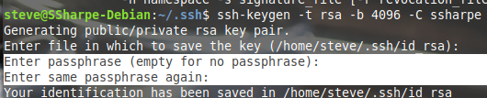
Key creation - passphrase
Putting a passphrase on a private key is in the case of theft of key. Without a passphrase someone can use your key immediately, but with a key they will need to begin brute force attacking. This buys you time to revoke the key.

Slide 27
Key creation - passphrase
Note: a passphrase on a private key is not an additional layer of authentication. If you are using solely your private key to authenticate and put a passphrase you’ll need to enter that key password every time you use the key, but you’re still authenticating solely so that would not be 2FA.

Slide 28
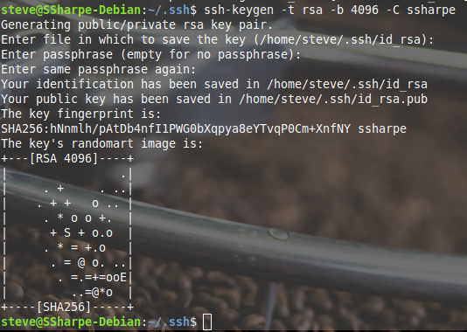
Final output
We have a final keypair with a key length of 4k

Slide 29
The subdirectory .ssh
Remember hidden directories start with a period, so .ssh is a hidden directory.
We don’t hide files for security reasons, we hide files to be tidy.

Slide 30
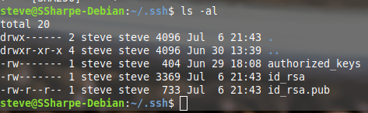
These files look familar?
The pub and non-pub should look similar to the host key files.

Slide 31
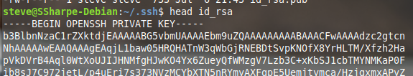
id_rsa
Private key

Slide 32
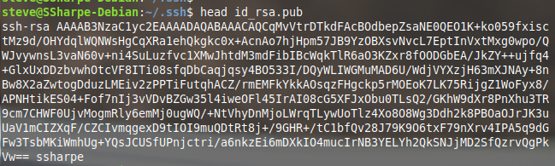
id_rsa.pub
Public key note the ssharpe at the end. This is the comment.

Slide 33
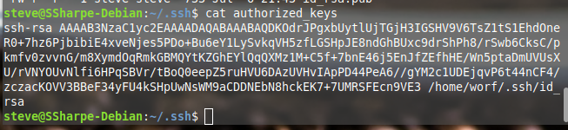
authorized_keys
This file is none, one, or many public keys
Notice this also has a comment

Slide 34
authorized_keys
This is present on the system that is accepting your login. It’s the target, where you’re going, etc.
On the target system all that needs to exist is ~/.ssh/authorized_keys which has to have your public key. It may have other people’s keys too.

Slide 35
On your system
You’ll need to have your matching corresponding private key in ~/.ssh/id_rsa

Slide 36
Note on comments
With comments we would have no clue who a particular public key belongs to. We fired Bugs Bunny so we want to remove his key. Without comments we wouldn’t be able to tell the difference between his key and Donald Duck’s key.

Slide 37
Let’s talk about the keys
Neither server actually sends any keys back and forth. Refresher
If you encrypt with the private key ONLY the public key and decrypt
If you encrypt with the public key ONLY the private key can decrypt

Slide 38
Cryptographic nonce
From Wikipedia “In cryptography, a nonce (number once) is an arbitrary number that can be used just once in a cryptographic communication.[1] It is often a random or pseudo-random number issued in an authentication protocol to ensure that old communications cannot be reused in replay attacks”

Slide 39
Challenge Response
Given the nonce definition on the previous slide the authentication is quite simple. The server create a nonce (some random number) encrypts with the public key in authorized_keys. The client decrypts, then re-encrypts with the private key which can be decrypted again with the public key. They match!

